Slide 1

Digitalization of Business Processes
Order-to-ship process in Foodservice Technologies industry
25DIGIBP4
Ellona Tsap, Patricia Abel, Ramona Steinauer, Lukas Janotka
Notes:
10 seconds. ​
We are proud to present how we automated the process of handling incoming Purchase Orders by customer service within Food-processing equipment manufacturer

Slide 2

AGENDA
Use Case
As-Is Process Challenges
Opportunities
To-Be Process
Automation with Make
AI Customer Agent
Future Oportunities
Notes:
10 seconds
We´ll have a look at the initial state, the challenges and how we have turned them into opportunities and solutions.

Slide 3
Use Case
Our proposed improvements automate your order-to-ship process, within the Foodservice Technologies business, supporting your position as a global leader in commercial food and beverage equipment. It enhances your commitment to delivering innovative, multi-category solutions that drive efficiency, sustainability, and superior customer engagement. Volume of orders
2500 orders / month​
8 pallets / day​
Stakeholders within the process​
Customer service​
Procurement​
Planning​
Dispatch
Notes:
Lukas 30 seconds: our as is process is an order-to-ship process, i.e. covers all aspects from receiving a PO to actually preparing the goods for shipment. In terms of the process scale, this process handles 2500 orders / month and 8 pallets a day and sees 4 departments involved, customer service, procurement, production planning and dispatch.

Slide 4
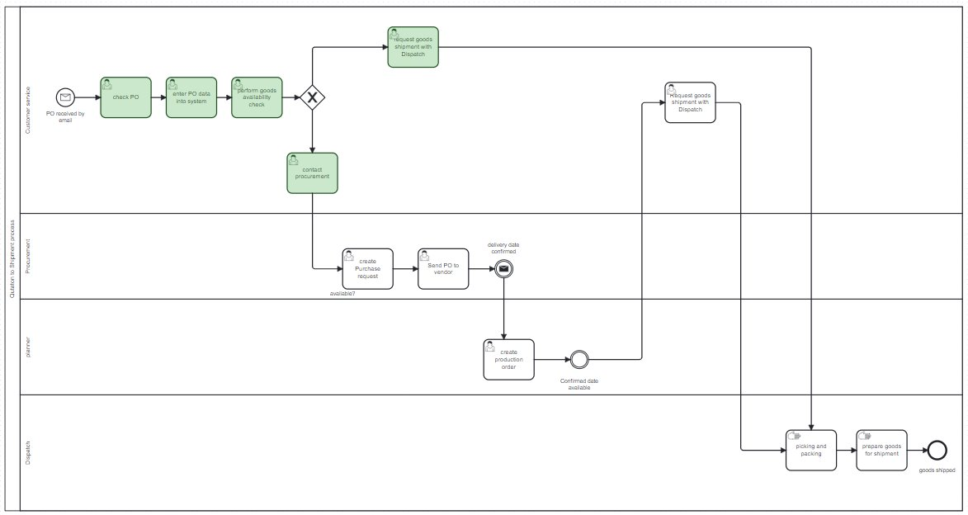

As-Is Process Challenges
Manual Communication Coordination between departments depends on manual notifications, leading to delays and errors.
Manual inventory check POs received by email, validated, and entered in the system manually.
Inefficient Follow-Ups Manual follow-ups Business → Vendors & Customers
Lack of Workflow Automation Leads to unnecessary workload and time losses.
Notes:
Lukas 30 seconds: In reality, process is split into two parts. Processing of the incoming POs and performing a goods availability check Afterwards, PO data is manually added into the system and goods availability check is performed (manually)- (green tasks). Depending on the outcome, customer service will inform the respective department on which task to perform next. The second part of the process (“white tasks“) are carried out by the procurement and preparation of gods for shipment. ​
​

Slide 5


Opportunities
Workflow automated​
Tasklist + process integration + standardized ordering
Automated Communication​
Customer Service = Procurement = Warehouse automated messaging
​
Automated goods availability check​
Fully automated and no errors​
Efficient follow-ups​
No time wasted
​
Improved customer experience​
Order status check and complaint handling​
Focus on automating and orchestrating
Notes:
The redesigned process focuses on automating and orchestrating the end-to-end process. By leveraging Camunda, Make, and Voiceflow, we were able to eliminated many manual user tasks and automate not only the whole workflow but also part of the communication as well as the goods availability check by introducing decision automation based on stock availability in a Make Scenario.
We further enabled real-time data flow for efficient follow-ups which enables seamless collaboration between departments, reducing human errors, and significantly speeding up both vendor handling and customer communication and with that also improving our customer experience.
How this is implemented Ellona and Patricia will explain to you within the next slides

Slide 6

To-Be or not To-Be
(process)
- William Shakespeare

Slide 7
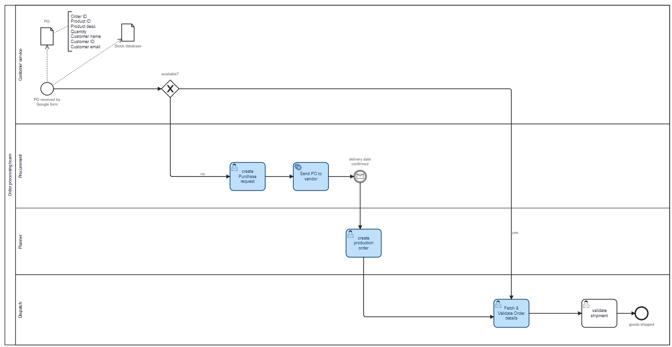


To-Be Process
Google Form replaces email orders
No user tasks within customer service
3 automated emails
No more manual tasks within Dispatch team
No need for unnecessary communication Planner → Customer Service → Dispatch
Notes:
Ellona 60 seconds: Let´s have a look at our To-Be and how the tools will help simplify, automate, remove waste and, potentially even save costs.​
We found two major opportunitites that can be automated. 1. ​Make and the integration with Caumunda practically eliminate the need of customer service involvement, so, once the availability check is done by make, depending on the outcome, we move directly to Procurement or Dispatch. 2. Make automates the email responses to customers and vendors – saving precious times of your colleagues to focus on more business critical needs.

Slide 8

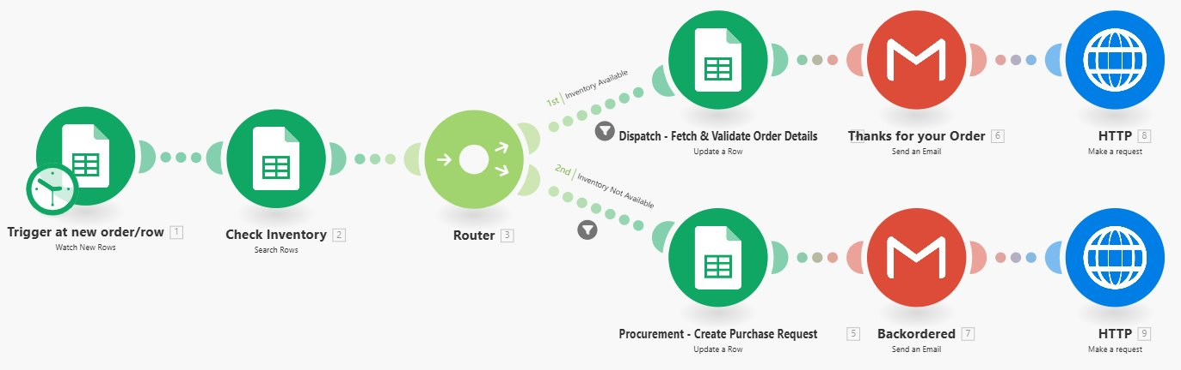
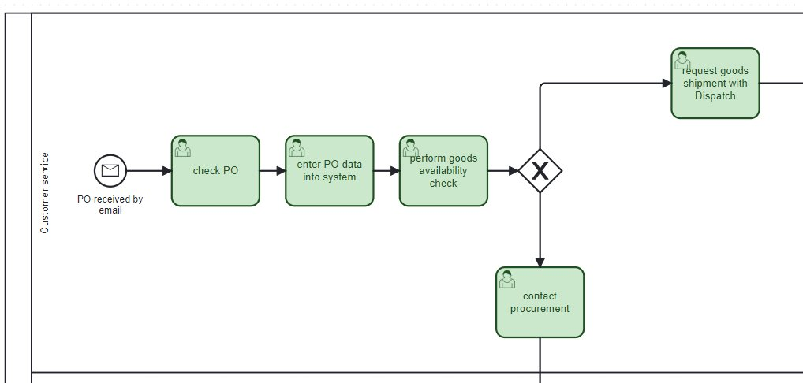
Process Automation – Make
Make triggers as soon as new order is entered
Inventory check is performed
Product available Yes/No
Email sent to the customer Thanks/Backorder
Process starts in Camunda
Notes:
Ellona 60sec Lets take a closer look at Make Scenarios Make triggers the process in camunda as soon as an order is submitted It then checks the inventory based on the product ID within the order and Routes to their Inventory Available or No – this is essentially where the decision is made. Make then updates the status to either Procuremenr or Dispatch within the Google Sheets (for reference by internal departments if needed) An email is then automatically sent to the customer informing them of a backorder or thanking them for the order and providing a standard delivery time frame.

Slide 9
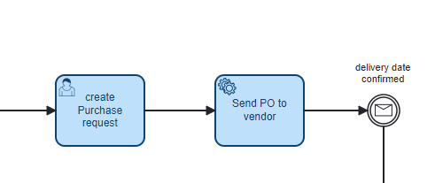
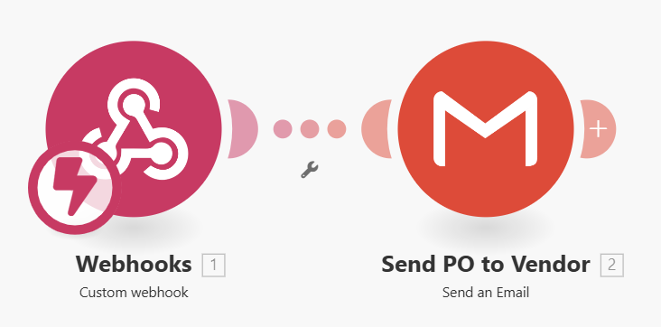
Process Automation - Make
Once the Purchase Request is created, Camunda will signal Make and an automated email will be sent to the Vendor ordering the needed product and asking for a confirmed delivery date.
Notes:
Ellona 30sec Once the Purchase Request is created Camunda will signal Make and an automated email will be sent to the Vendor ordering the needed products and asking for a confirmed delivery date

Slide 10
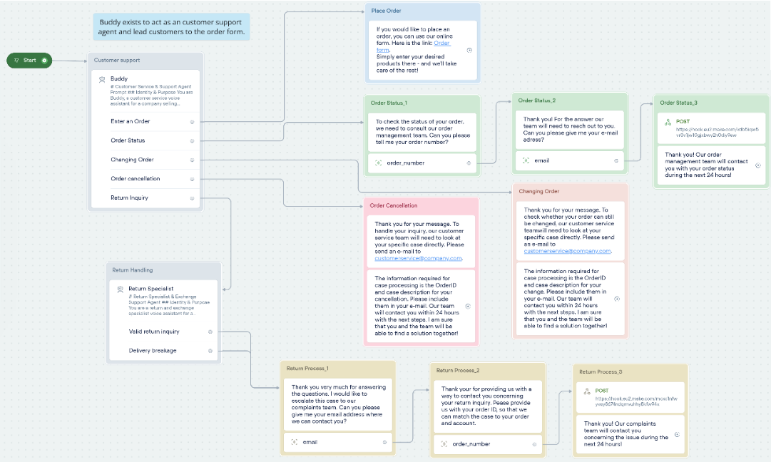
AI Customer Agent
Notes:
Patricia 180 seconds:
Additional service: Chatbot Buddy
Modelled in Voiceflow
reduces workload for customer service.
customers can get immediate and accurate answers about order status, complaints, and more—without waiting for manual replies.
The main LLM Agent in the voiceflow has a comprehensive knowledge base to handle the customers inquiries

Slide 11
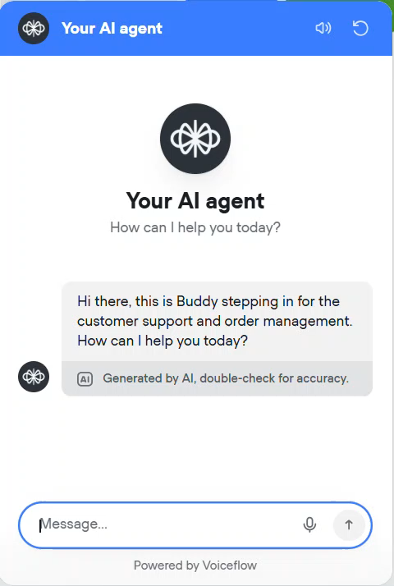
AI Customer Agent
Order Placement
Notes:
Patricia
When customers want to place an order, Buddy guides them by sharing a sample text and a direct link to our digital order form.
Ensures a smooth start to the ordering process

Slide 12

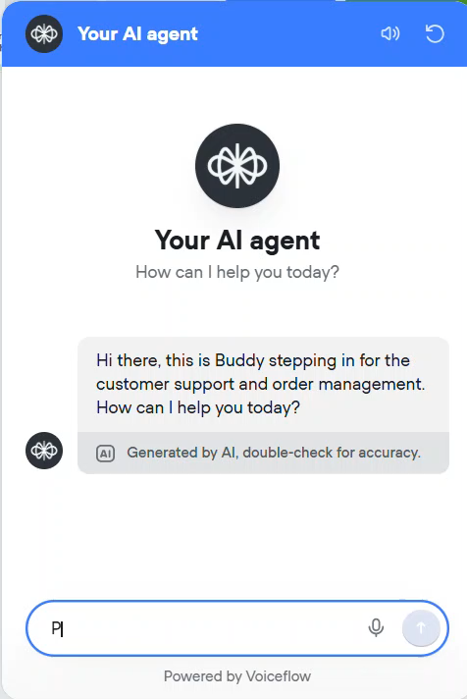
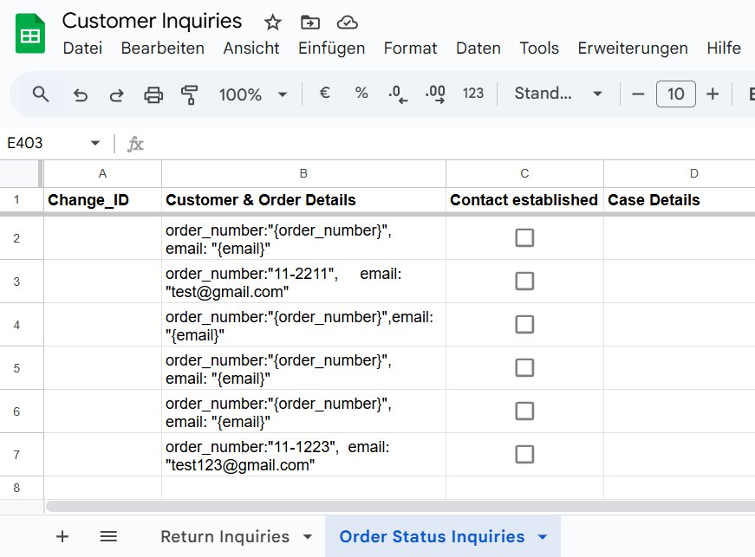
AI Customer Agent
Order Status Inquiry
Notes:
Patricia
For order status requests, Buddy asks for the order number and email address
Information gets send via a MAKE flow to the Customer Inquiries gSheet
Here the team can prepare themselves for the customer contact and follow up the request within 24 hours, leaving a good impression on the customer

Slide 13
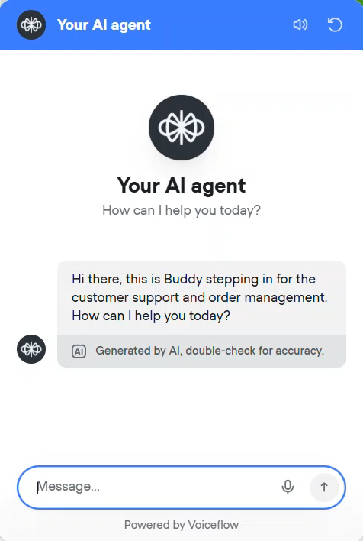
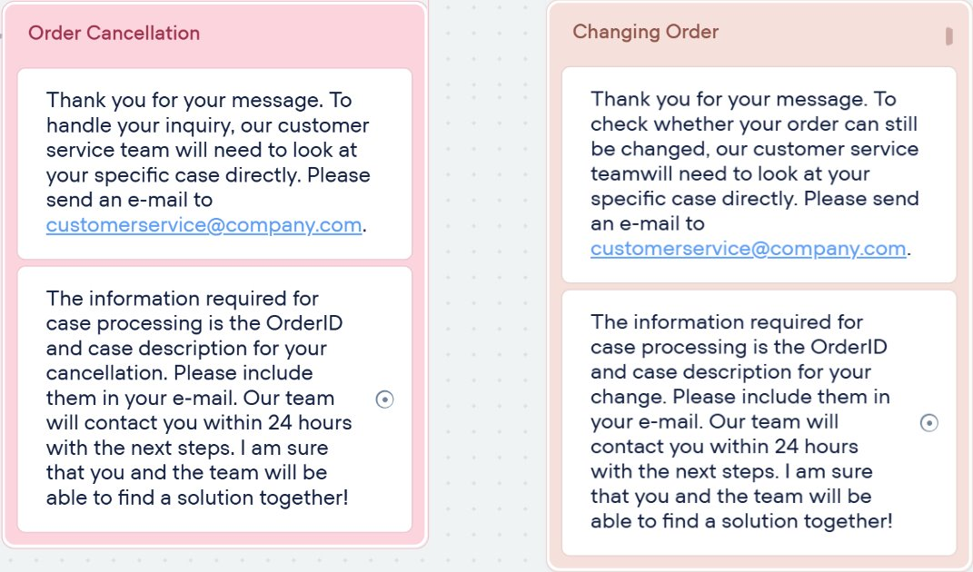
AI Customer Agent
Order Change Request
Notes:
Patricia
- For order changes or cancellations, Buddy explains that these require direct communication with the customer service team.
Customers are prompted to email their order details
intentionally adds a small hurdle to discourage excessive changes and cancellations.

Slide 14
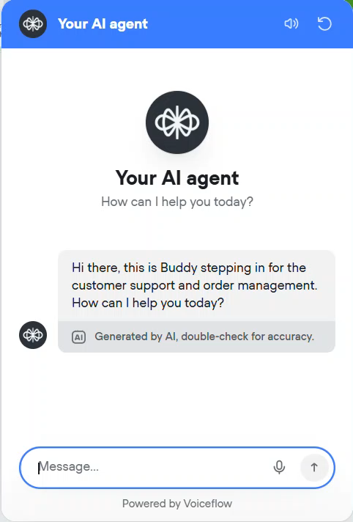
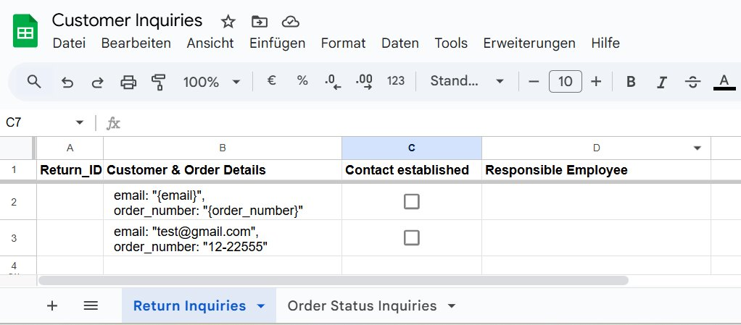
AI Customer Agent
Return Inquiry
Notes:
Patricia
Return inquiries are handled by a second specialized agent, the Return Specialist.
Prevents overload in the chatbot’s main knowledge base & gives higher quality answers
When a customer wants to return a product, the Return Specialist checks the validity and sends the claim to the complaints team
The internal complaints team will get the notification about the return inquiry

Slide 15
Future Opportunities
OPPORTUNITY | SUGGESTED SOLUTION
Returns Process | Currently “officially” returns are not allowed, however, they can be done with prior written authorization from the seller – therefore, since there are some returns happening we recommend establishing a proper returns process and either incorporate this into our proposed To-Be process or establish a separate process. A closer business review is needed.
Optimize Order Form | Update order fields to specifically match your expectations. Make sure the Order ID is autogenerated and not a required field for the customer.
AI Agent Capabilities | Expand the capabilities of the AI Customer Agent to handle a variety of more complex queries, add a variety of languages, integrate with your hotline to ensure 24/7 availability for customers.
Cost-Savings | Review the structure of customer service team and possibly reorganize the resources as with our proposed automation the role of customer service department is practically obsolete – potentially saving costs.
Integration ERP/CRM | To align closer with the business need we advise to explore the potential to integrate the proposed changes with internal ERP and/or CRM systems for a an even more seamless process e.g. pull inventory availability directly from SAP
Notes:
Ramona 90 Seconds
Thank you very much Patricia and Ellona
To conclude we also would like to give you a quick outlook on further opportunities we see or like to improve
Currently “officially” returns are not allowed, however, they can be done with prior written authorization from the seller – therefore, we recommend establishing an official and proper returns process.
In regard of the Google Form, before implementing we would need to update the order fields to specifically match your expectations and make sure the Order ID is autogenerated and not a required field for the customer.
As already quickly mentioned, our AI Agent Buddy has great potential, his abilities are expandable as for e.g. to handle a variety of more complex queries, to speak different languages, or to integrate with our hotline to ensure 24/7 availability for customers.
The elimination of the manual tasks allows to not only safe costs within the process but also to restructure our customer service team and allocate our resources more efficiently to more important tasks and project ahead.
To align closer with the business need we advise to explore the potential to integrate the proposed changes with internal ERP and/or CRM systems for a an even more seamless process e.g. pull inventory availability directly from SAP

Slide 16
Thank you.
Notes:
And with that I hope you are as exited and convinced as we are and we are looking forward to put this improvements to test in our real life scenario.

